Slide 1

NORH REGION
DELHI ZONE
FORGIVENESS AND RECONCILIATION PROGRAMME-2
(FRP- Level-2)
DATE:05/11/21 TO 16/11/21

Slide 2


Slide 3

DATE- 05/11/21 TO 16/11/21
DURATION:9 DAYS
COORDINATORS
Sol. Neha
Sol. Renu Solanki
Sol. Sanjeeta
Sol. Jasmine
Sol. Dr Gita

Slide 4

SUMMARY
BY THE GRACE OF GOD AND WITH THE HELP OF HOLY SPIRIT ONLINE FRP LEVEL-2 WAS SUCESSFULLY COMPLETED IN NORTH REGION: DELHI ZONE.
Total Participants:
!7- 24 ONLINE

Slide 5
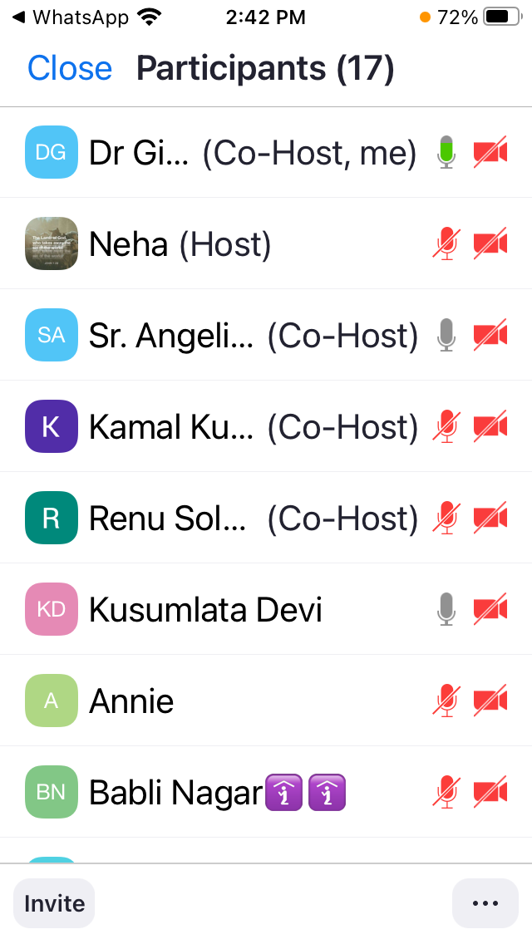
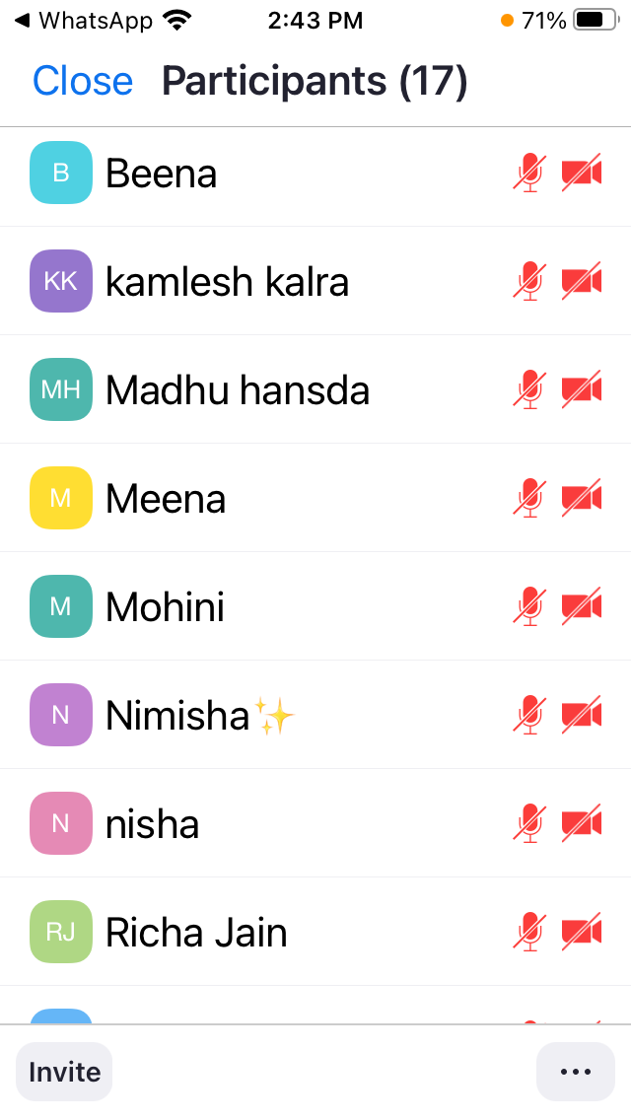
PARTICIPANTS

Slide 6


LIST OF TEACHERS
Sol. Dr Gita
Sol. Pradeep (3 Lessons)
Sr. Angelica
Sol. Kamal
Sol. Luiza
Sr. LeemaRose
(Class 8 done in 3parts

Slide 7

LIST OF PARTICIPANTS INTERESTED IN TEACHING,ORGANISING,COORDINATE
Sol. Neha
Sol. Lissy
Sol Mohini
Sol Kusamlata
Sol Beena
Sol Richa Jain

Slide 8
TESTIMONY OF FRP-2
Sol Beena was blessed during Anointing 7 is motivated to take the Course to students in Karol Bagh
Sol Richa now feels stron to be able to share tha Word of God. She is now ready to undertake the work of the Kingdom of God. She is glad to learn about Heavenly Court

Slide 9
Sol Mohini has learnt many things through this course. She is now able to receive Revelations & can Prophesy. She feels like this is her spiritual family. She has alred started her troop Church with participants from Dehradun & uttranchal. She wants God to use her for His Kingdom purposes

Slide 10

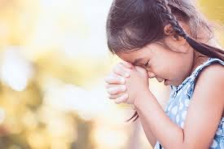
FIRST AND FOREMOST WE ARE VERY THANKFULL TO GOD FOR HIS PROTECTION, ENCOURAGEMENT & GUIDENCE
WE ARE ALSO THANKFULL TO ALL THE SOLDIERS WHO HELPED.
HUGE THANKS TO ALL PARTICIPANTS.

Slide 11

With A Grateful Heart, We Thank the Following Sol’s for Helping with the Translation:
Sol Neha

Slide 12


Slide 13


